Slide 1
Operationalizing Python ML models in a web app using Flask
Narayana Swamy

Slide 2
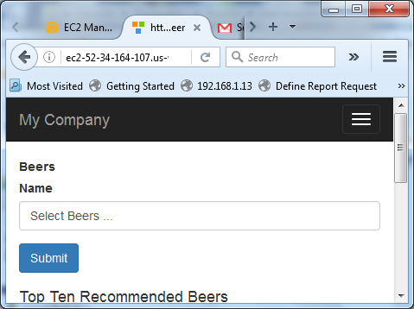
Recommendation System Demo
http://ec2-52-34-164-107.us-west-2.compute.amazonaws.com/site/beer

Slide 3
Examples
Retail: Amazon
Movie: Netflix
Friends: Facebook
Professional connection: LinkedIn
Websites: Reddit

Slide 4
Item-Item Collaborative filtering
Item-item collaborative filtering, or item-based, or item-to-item, is a form of collaborative filtering based on the similarity between items calculated using people's ratings of those items.
Item-item collaborative filtering was first published in 2001, and in 2003 the e-commerce website Amazon stated this algorithm powered its recommender system.
The authors Badrul Sarwar, George Karypis, Joseph Konstan, and John Riedl won the 2016 Test of Time Award for their paper Item-based collaborative filtering recommendation algorithms. The International World Wide Web Conference committee stated that "this outstanding paper has had a considerable real-world impact".^{[1]}
Can be extended to User-Item Collaborative Filtering

Slide 5



Finding Similar Beers
Calculate pair-wise similarities
Euclidean Distance: Simple, but subject to rating inflation
Cosine similarity: better with binary/fractional data
Pearson correlation: continuous variables (e.g. numerical ratings)
Others: Jaccard coefficient, Manhattan distance

Slide 10
Beer Correlation matrix

Slide 11
Selecting Similar Beers

Slide 12
Total distance of the Beers

Slide 13
Sort the total distance

Slide 14
Filter out the Beers that the user chose

Slide 15
Return the Recommended Beers

Slide 16
Steps in Operationalizing Python ML model
Build a trained ML model from the data set
Beer Reviews data
Save a binary version of the trained model
Pickle the trained model
Load the trained model in a Flask application
__init__.py, resources.py
Make the Apache web server able to talk to the Flask application using mod_wsgi
WSGI is a specification that describes how a web server communicates with Python Web applications.
Install mod_wsgi, activate module using a2enmod mod_wsgi, create wsgi file to run the python Flask application - flaskapp.wsgi
Enables apache httpd to call python applications
http://flask.pocoo.org/docs/0.10/deploying/mod_wsgi/
Create VirtualHost on apache to listen to the mod_wsgi server on port 8081
Make Curl calls to the Flask application from the web app

Slide 17
Python ML Beer Recommendation model
Beer Recommender Model Github site
http://flask.pocoo.org/docs/0.10/deploying/mod_wsgi/

